Slide 1
Week 9
Australian Academy of Science
Supercomputing Demand Forecast

Slide 2
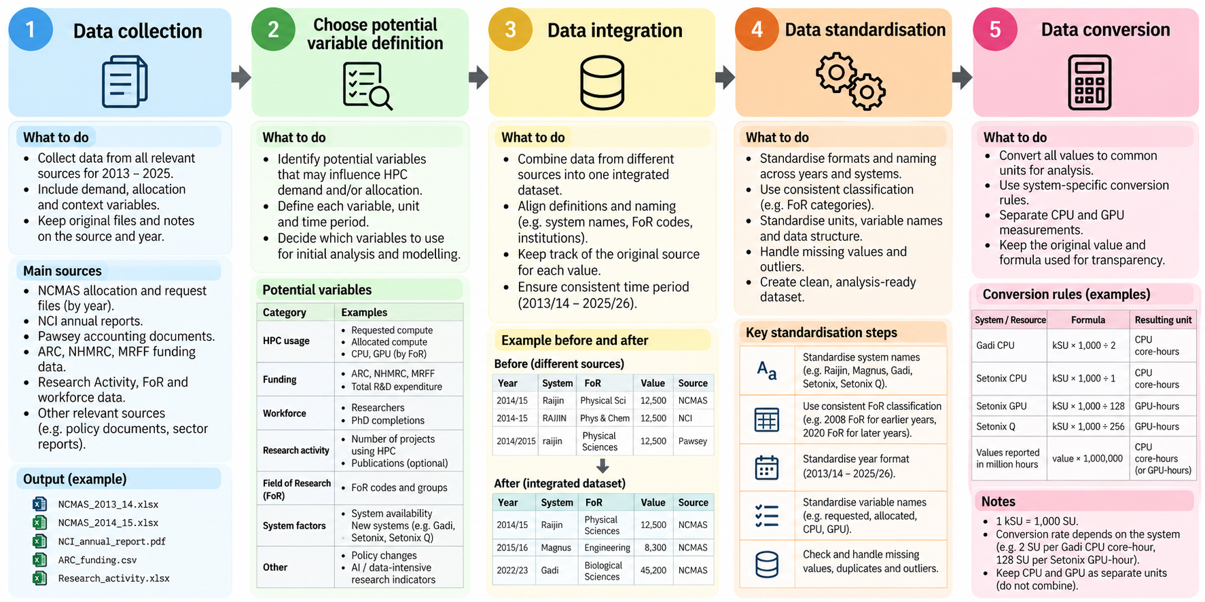

Slide 3
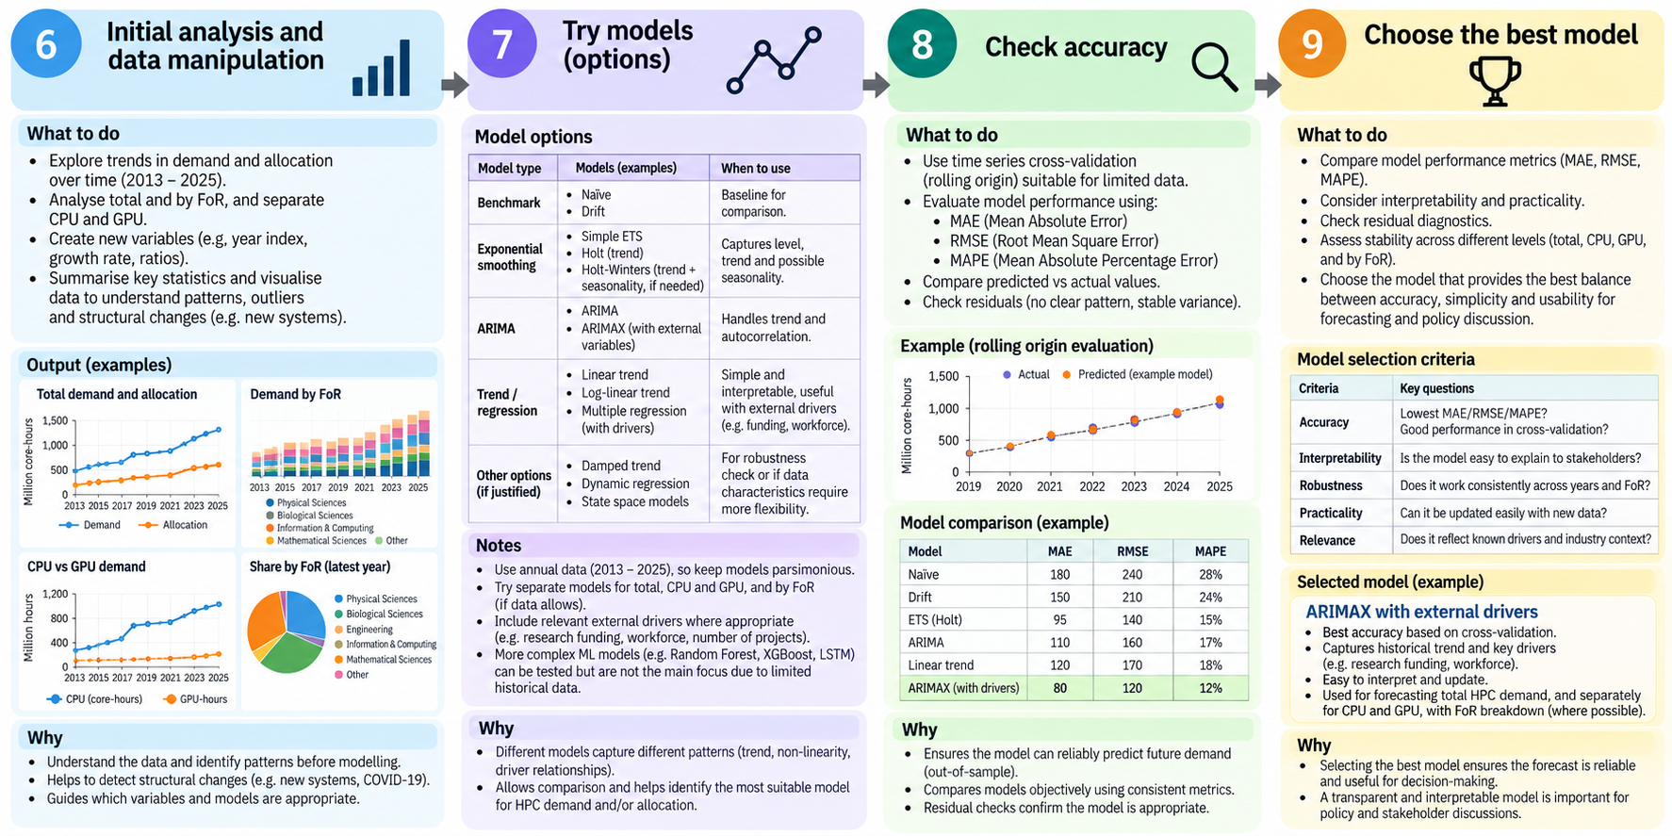

Slide 4
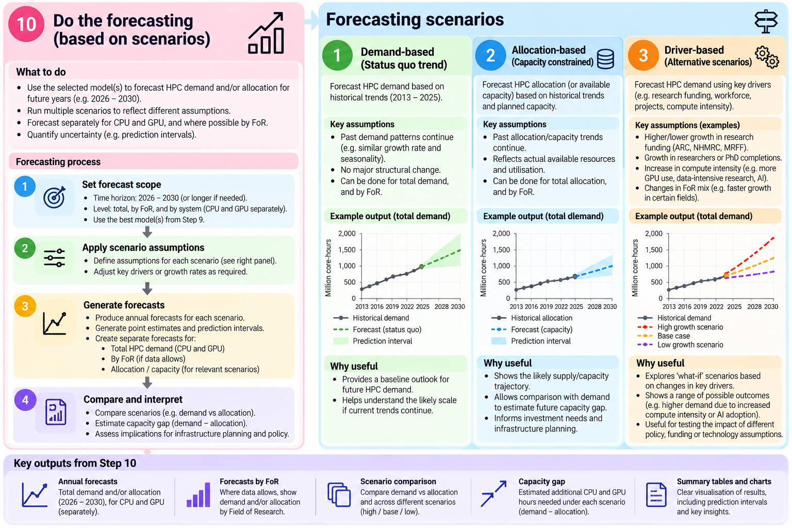

Slide 5
Questions
So far, I’ve collected the data from publicly available sources, including the NCI and Pawsey websites, annual reports, NCMAS reports, PDFs and Excel files. This is the summary I’ve built so far. Could you please confirm whether these are the right sources to use, and whether there is anything I should be careful about when comparing the figures across different years?
For requested demand, allocation and Field of Research breakdowns, I haven’t been able to find consistent data before 2013. Do NCI or Pawsey have historical data from before 2013 that you could share with us, or could you point us to where we might find it? A longer historical series would be very useful for forecasting, because right now I only have about 13 annual observations.
The third question is about converting the compute units. I found that the conversion isn't consistent across systems and years, so rather than applying one conversion to the whole dataset, I’m using the conversion documented for each system. For example, for Gadi I currently use kSU × 1,000 ÷ 2 to get CPU core-hours, while for Setonix GPU I use kSU × 1,000 ÷ 128 to get GPU-hours. These are the sources and conversion rules I’ve found so far. Could you please confirm whether this is the right way to interpret these conversion factors, particularly for the historical systems? And are there any changes in the accounting method over time that I should know about?

